Slide 1

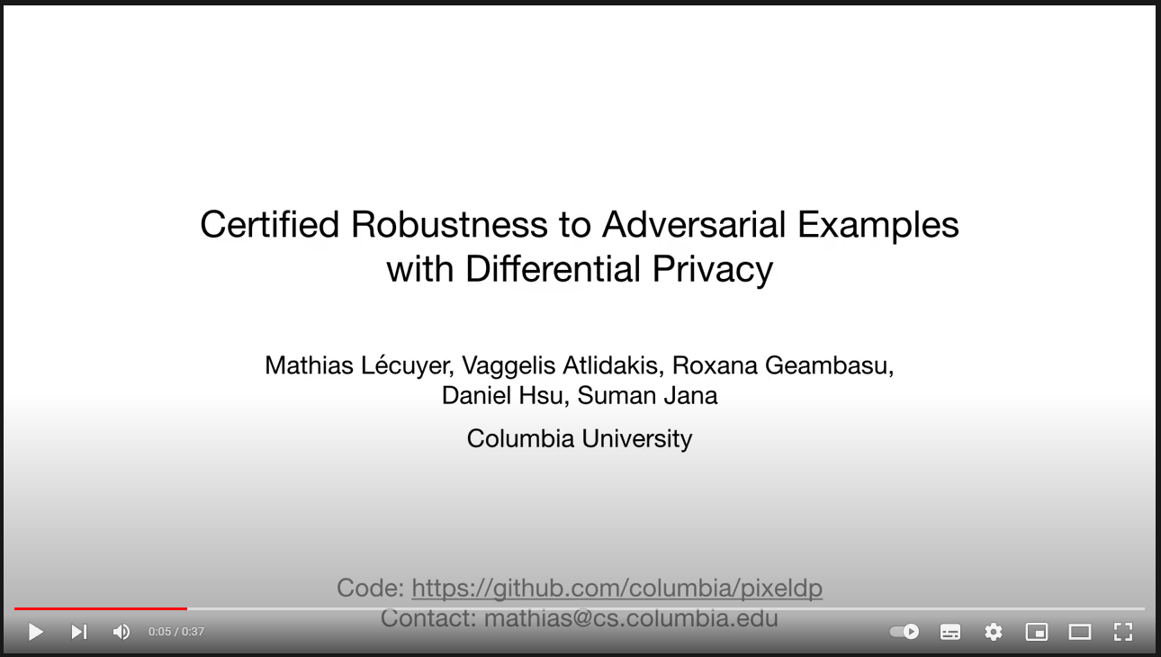
Scalable Differential Privacy with Certified Robustness in Adversarial Learning
NhatHai Phan, My T. Thai, Han Hu
New Jersey Institute of Technology
ICML2020

Slide 2
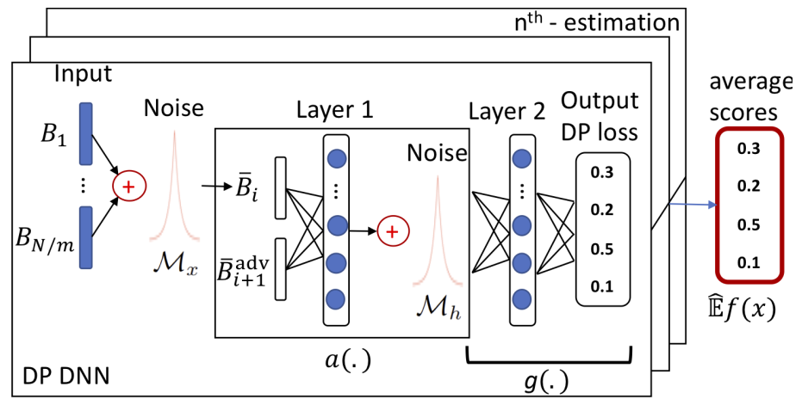
Differential Privacy
Overview
Scalable Differential Privacy with Certified Robustness in Adversarial Learning
Lecuyer, Mathias. Certified robustness to adversarial examples with differential privacy. IEEE S&P 2019.

Slide 3
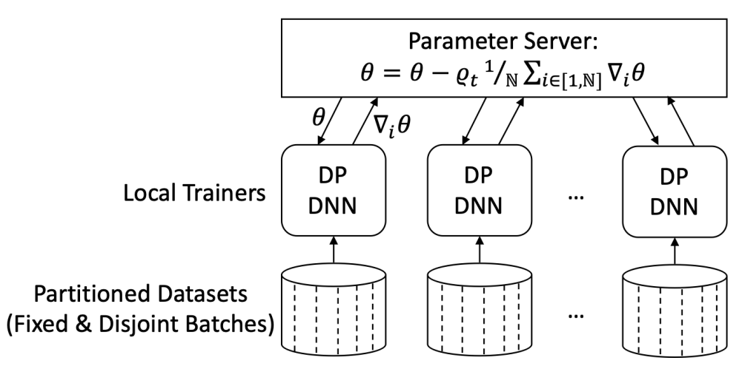
Differential Privacy
Overview
Certified Robustness to Adversarial Examples with Differential Privacy (S&P 2019)
Lecuyer, Mathias. Certified robustness to adversarial examples with differential privacy. IEEE S&P 2019.

Slide 4
Differential Privacy
Authors
Lecuyer, Mathias. Certified robustness to adversarial examples with differential privacy. IEEE S&P 2019.

